Slide 1
"Building the CSE Department Portal: My Full-Stack Internship Journey at Abhivriddhi Infotech "
Presented by: B Ruchitha
Date: 24/4/25

Slide 2

CSE Department Portal: Full Stack Internship at Abhivriddhi Edutech
Overview: Interned at Abhivriddhi Edutech, Ballari, Karnataka, from Dec 18, 2024, to Apr 12, 2025. Developed the CSE Department Portal for students to access academic resources and admins to manage them securely.
Organization Details:
Mission: Providing efficient, long-term software solutions to enhance business performance.
Vision: To be a prime name in software development, promoting business growth through modern technology.
Services: Website development, software training, digital marketing, internship programs.
Structure: Development and training teams, with mentors like G. Abhilash Naidu guiding interns.
Role: Full-stack intern, built React frontend and integrated with Spring Boot backend.

Slide 3
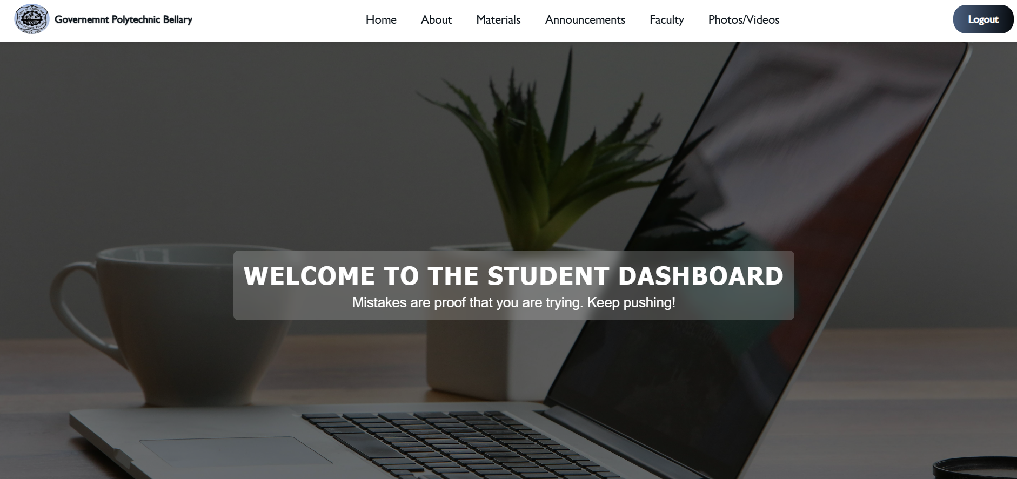
CSE WEB PORTAL
Introduction:
The CSE Department Portal is a web application developed for the Computer Science and Engineering department. It enables students to access academic resources like study materials, syllabi, and announcements, while admins can manage these resources securely with full CRUD operations. The project focuses on a user-friendly interface with glassmorphism design and secure backend integration.

Slide 4
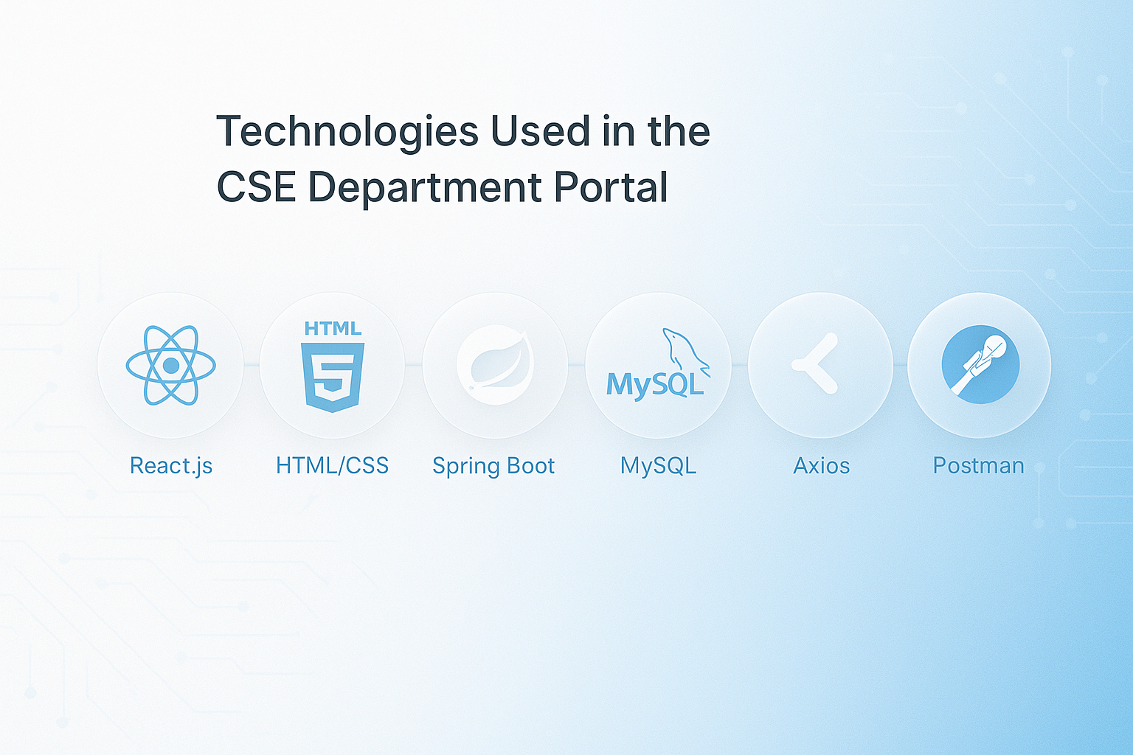
Technologies Used:
Frontend: React.js, HTML, CSS (glassmorphism design and responsive layouts) and JavaScript
Backend: Spring Boot, Spring Security (for authentication with JSESSIONID)
Database: MySQL
API Communication: Axios (for secure API calls between frontend and backend)
Testing: Postman (for API testing)

Slide 5
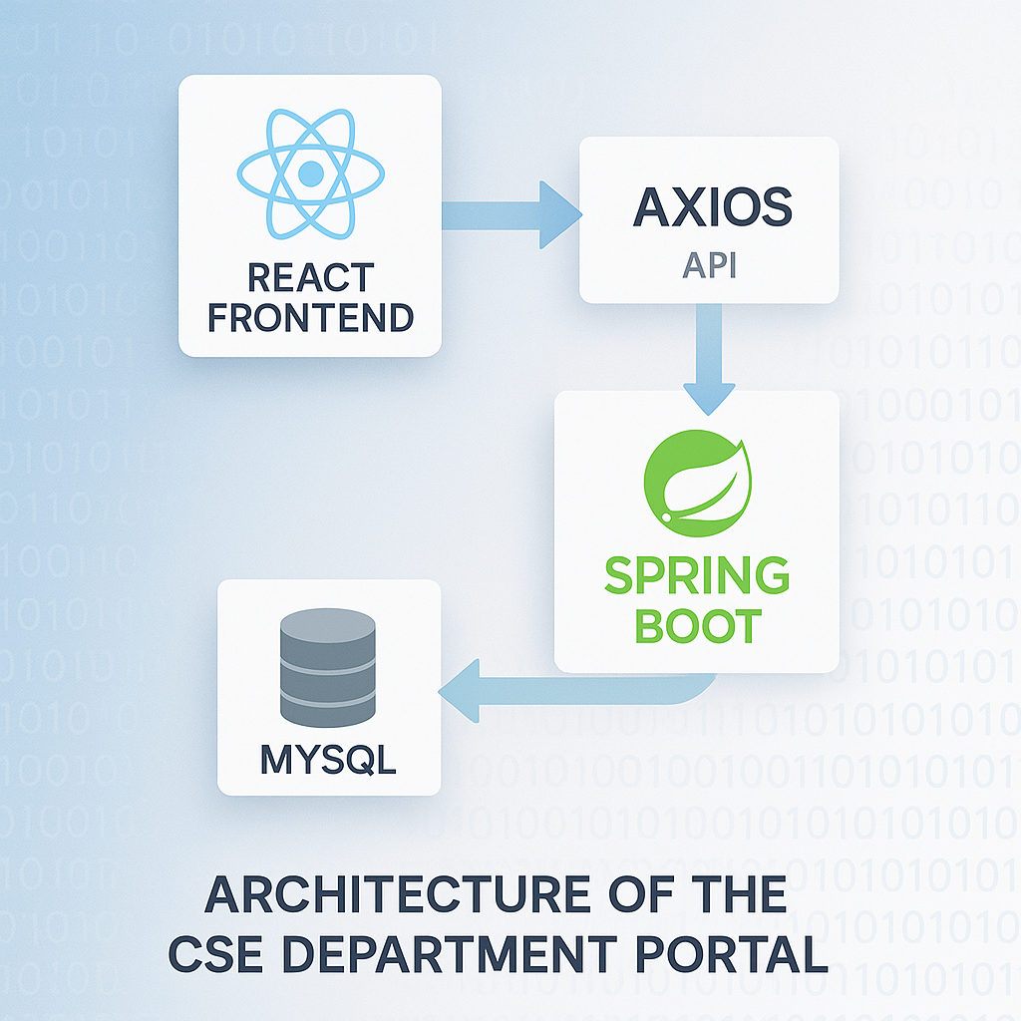
System Architecture:
The portal follows a client-server architecture:"
Frontend (React): Handles UI with components like App.js (routing), Auth.js (login), and dashboards (StudentDashboard, AdminDashboard).
API Layer (Axios): Manages secure communication using JSESSIONID for session-based authentication.
Backend (Spring Boot): Processes requests via controllers like UserController and MaterialController.
Database (MySQL): Stores data in the project schema, including users, materials, and announcements.

Slide 6
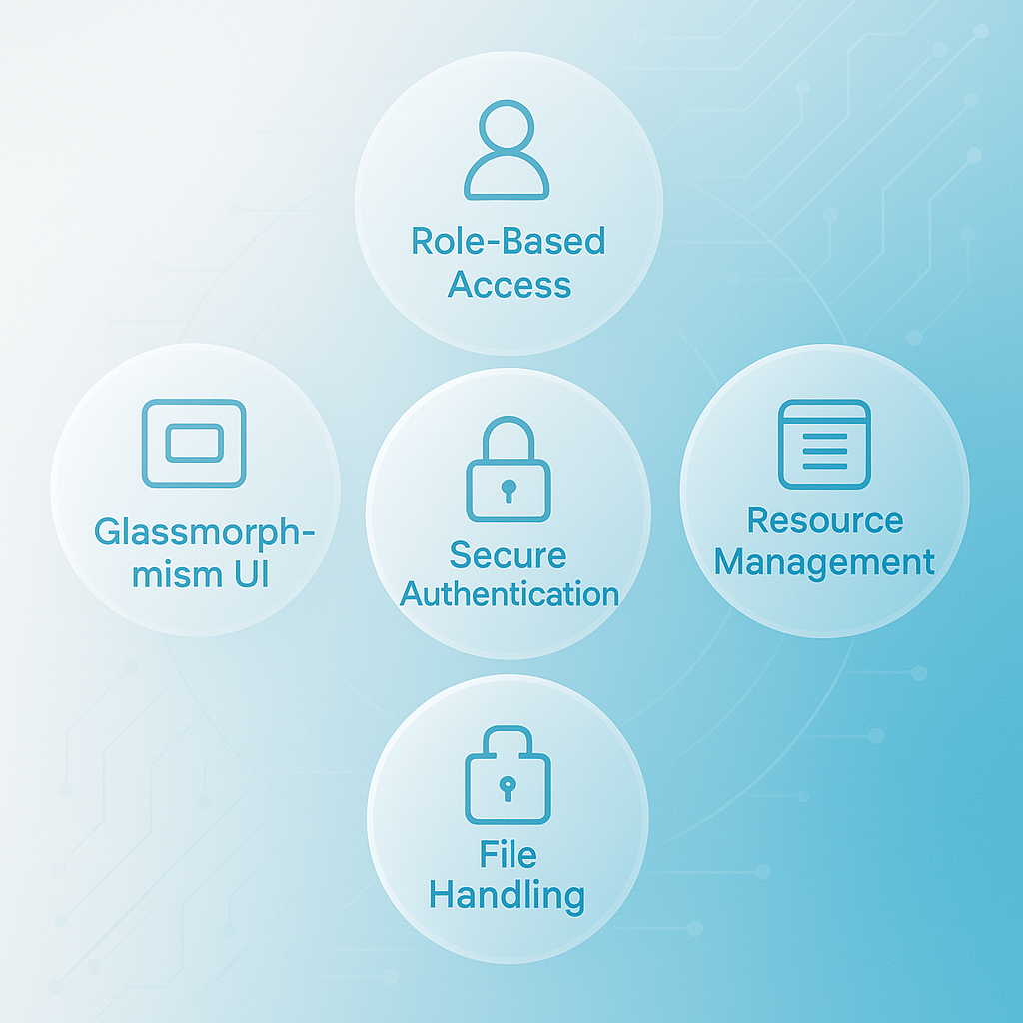
Core Features:
Role-Based Access: Separate dashboards for students (ROLE_STUDENT) and admins (ROLE_ADMIN).
Resource Management: Admins can perform CRUD operations on materials, announcements, and syllabus.
Secure Authentication: Uses JSESSIONID for session-based access with Spring Security.
Glassmorphism UI: Modern design with #8ab1e8 accents, pulse animations, and responsive layouts.
File Handling: Supports file uploads (e.g., notes.pdf) stored in E:/Project/uploads/.

Slide 7
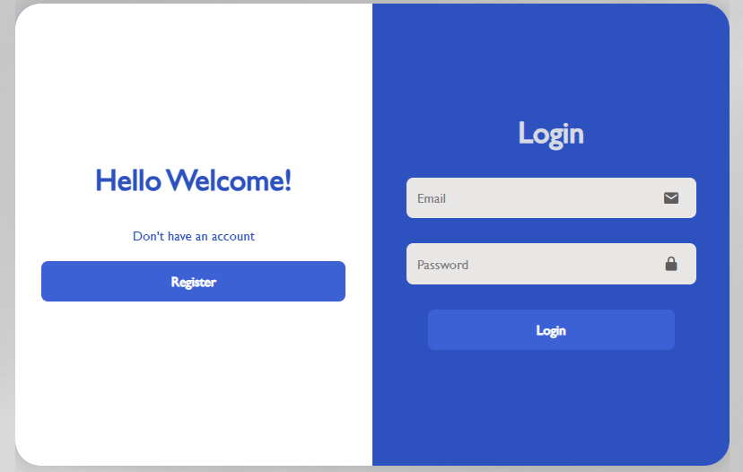
OJT-I: Frontend Development at Abhivriddhi Infotech
Role: Web designer/developer, focused on React, HTML, and CSS for the CSE portal.
Skills Applied: Developed React components: App.js (routing), Auth.js (login), MaterialForm (forms).
Designed glassmorphism UI with #8ab1e8 accents, pulse animations, and responsive layouts (768px, 480px media queries).
Tested and fixed UI bugs for smooth functionality.
Learning: Gained hands-on UI/UX design and collaboration skills with mentor feedback.
Problems Faced:
Responsive design issues: Struggled with form layouts across devices, fixed with media queries (768px, 480px).
Form submission errors in MaterialForm: Data wasn’t sent correctly, resolved by debugging FormData handling.

Slide 8
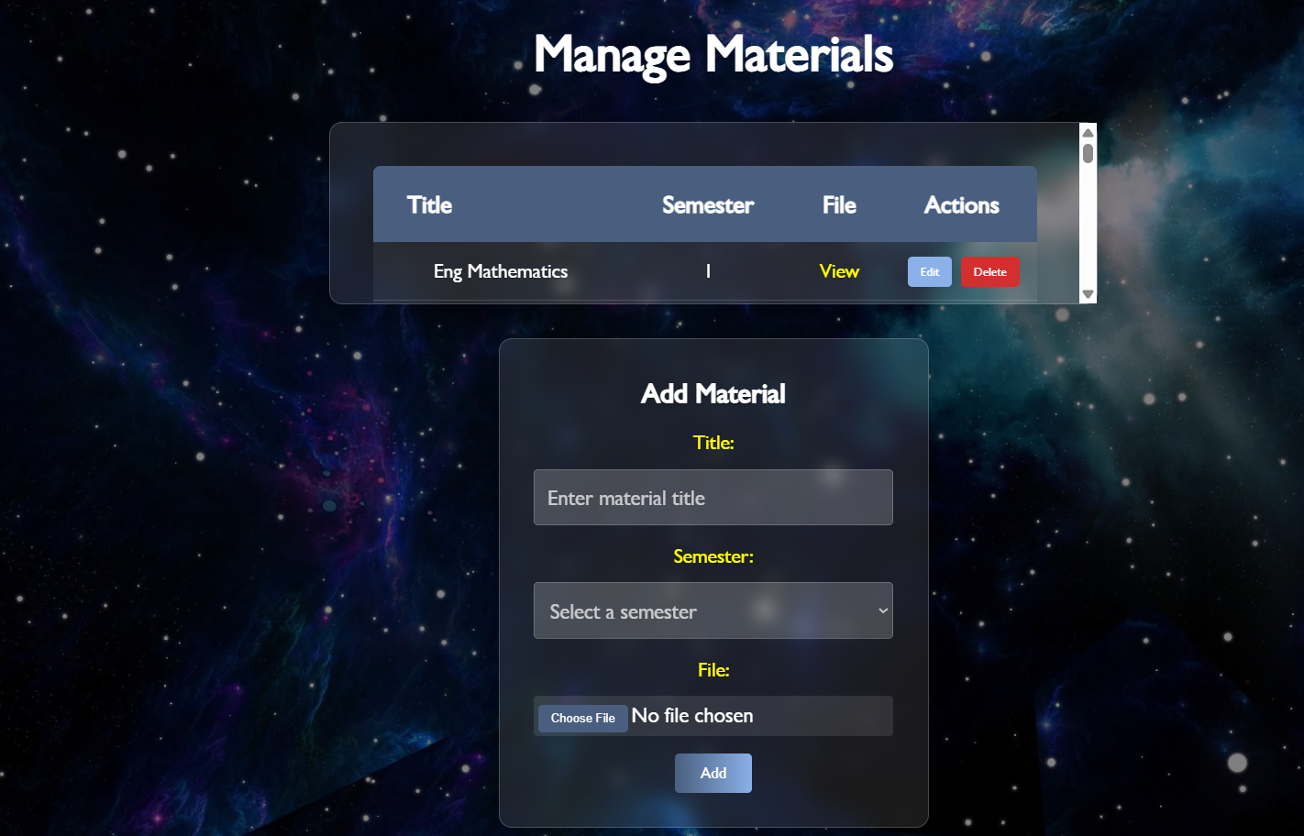
OJT-I Use Case: Admin Adding Study Material
Use Case: Admin adds study material via MaterialForm, which students can then access.
Demo Steps: Login as admin (admin@gmail.com, admin) → redirects to /admin.
Navigate to “Materials” in AdminDashboard, click “Add Material.”
Use MaterialForm to add “Java Notes” (Semester 3, notes.pdf).
Show updated materials table.
Resize window to demonstrate responsive form layout.

Slide 9
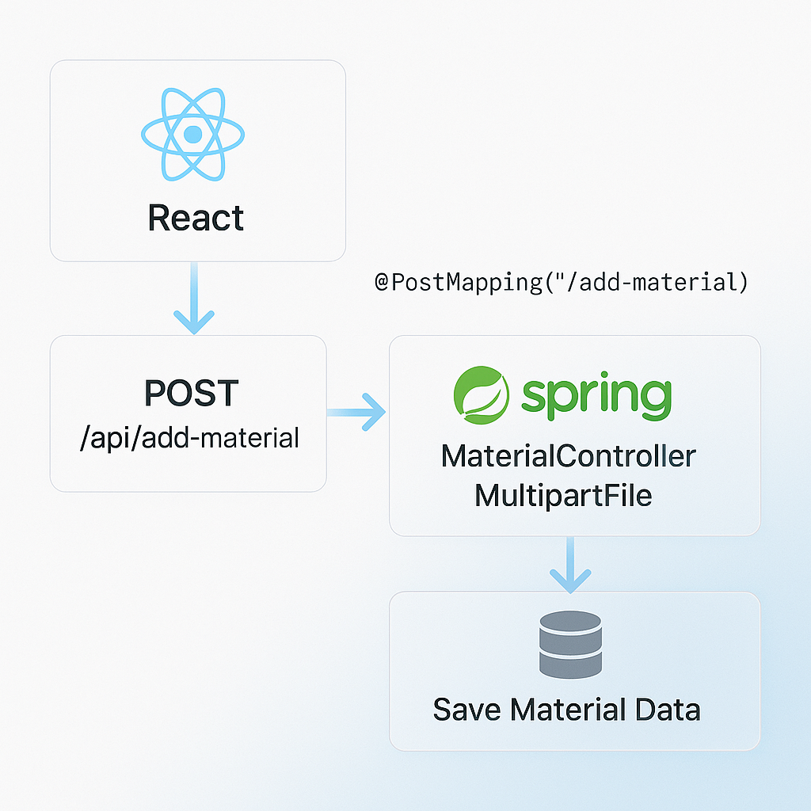
OJT-II: Backend Development at Abhivriddhi Infotech
Role: Backend developer, integrated frontend with Spring Boot and managed database operations.
Skills Applied:
Used axios.js with withCredentials: true for secure API calls with JSESSIONID.
Implemented file uploads in MaterialController using MultipartFile, storing files in E:/Project/uploads/.
Fixed CORS issues (March 30, 2025) with @CrossOrigin and 401 errors (March 28, 2025) with role checks.
Learning: Developed backend integration, security, and debugging skills with mentorship.

Slide 10
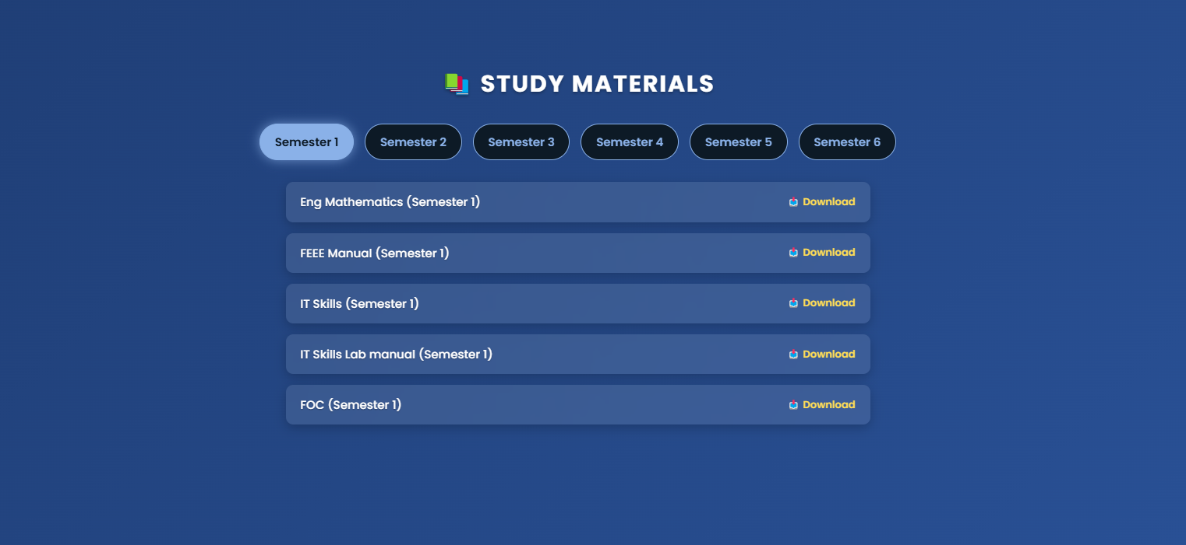
OJT-II Use Case: Student Accessing Materials
Use Case: Student accesses material in StudentDashboard, showing end-to-end functionality.
Demo Steps:
Logout from admin, login as student (student@gmail.com, student) → redirects to /student.
In StudentDashboard, select Semester 3, verify “Java Notes” is listed.
Open material in a modal to show file viewing.
Logout to show redirect to /auth.
Problems Faced:
CORS issues (March 30, 2025): Frontend-backend communication failed, fixed with @CrossOrigin.
401 errors (March 28, 2025): Authentication issues due to role mismatches, resolved by validating roles in Spring Security.

Slide 11
“Thank you for your time and attention!”
Proud to share my journey with the CSE Department Portal.
Presented By: B Ruchitha
Date: 24/4/25

